Slide 1
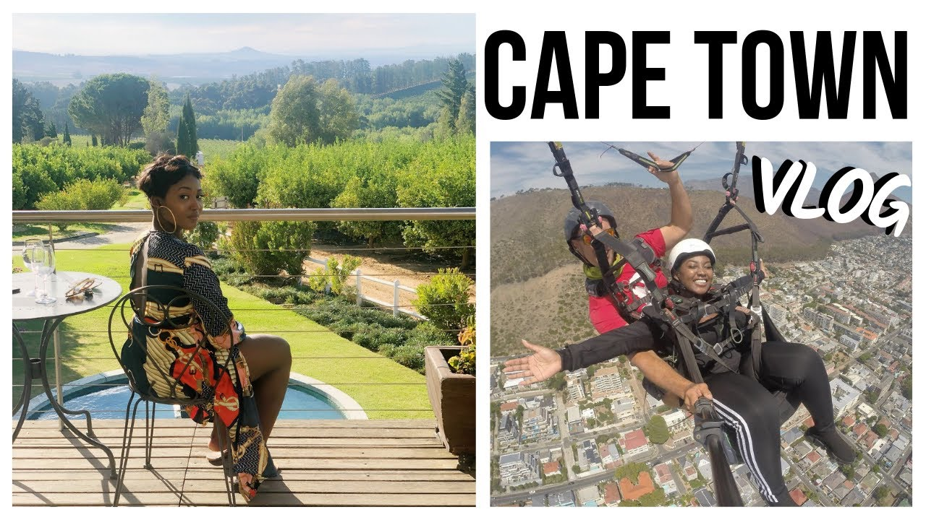
Applications Development Theory 4 Tourism Boom Resolution: TourSpace
Kabai Moipone 215203569
Msomi Sebe 216028604
Due Date: 26 February 2019

Slide 2
Feasibility REPORT
Before considering an implementation for our tourism system, we first checked with LoveCapeTown tourism system and tried to understand how their system works in accommodating the increasing population of tourists and how they help them in making their journey to Cape Town enjoyable.
So, we propose to implement a mobile system called TourSpace that will be accessible using any mobile device, and it is only for tourist who are visiting Cape Town.
The objective of this is to help them find the safest accommodations and the best activities in the City to entertain them as the LoveCapeTown claims that the way to attract tourists is to assure them of their security.
At the moment we know that our system is feasible and it can be implemented within a certain period of time, which
is May. It is valuable to the tourists to help them plan their tour to Cape Town by finding the most safest faces for accommodation an also the activities or things that they can do so that they don’t get bored when they get to Cape Town.

Slide 3
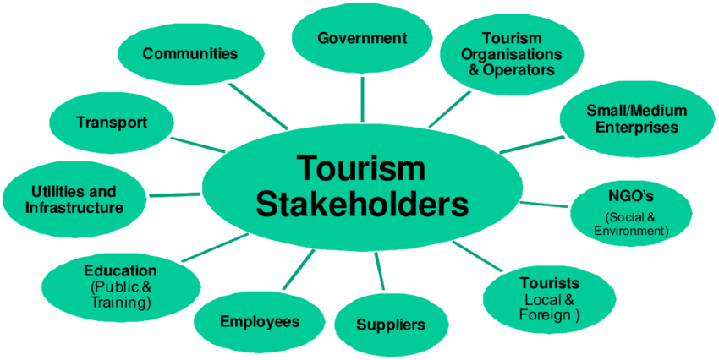
Stakeholder list
Owner
Manager
Software Developers
Tourists

Slide 4
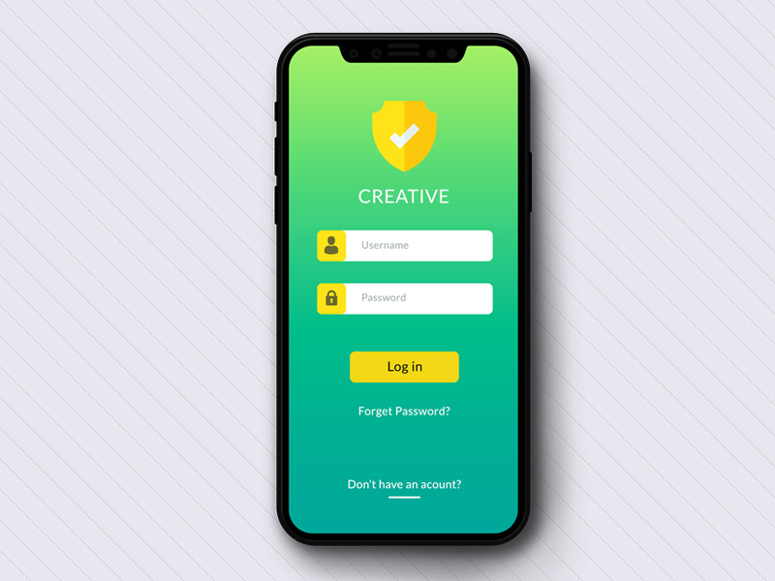
Requirements specification
Requirements specification is the process of writing down the user and system requirements in a requirements document. The user requirements for a system should describe the functional and nonfunctional requirements so that they are understandable by system users who don’t have a detailed, and technical knowledge.
For our system, the user requirements are as follows:
The software consultancy IT team should come with a development of a user-friendly software application which stands out from the multitude of options currently available to tourists, that will be beneficial for the tourism market.
Among other benefits, it will provide the most safest places for accommodation, and a variety of the best activities to do in Cape Town and exactly where they are located. No time will be wasted juggling around the Internet looking and typing out the hotel names and struggling to get the right places to go to for activities.

Slide 5
Requirements specification continues…
System requirements:
The system aims to put the tourists’ safety first above all else so that they get accommodated in the safest places in Cape Town and also not get easily scammed while they search the accommodation and get false alarms about places which turned out to be not accommodating anyone in the first place. This will reduce the number of deaths that happen on vacation because of unsafety.
(Nypost.com, 2020) states that “..the trip turned tragic when the Prince George’s County couple was found dead in their room five days after they checked into the hotel”. It continues by emphasizing “On the same day that Day and Holmes’ bodies were found, a Pennsylvania woman, died at the Luxury Bahía Principe Bouganville, another property under the same resort chain.”
In overall, this shows how most tourists get trapped in places they thought were the safest places to be. Our aim is to ensure that the tourists in our City are healthy are safe at all times so that they come back knowing they will enjoy their entertaining activities to their outmost best knowing they are going back to a very safe and secure place.

Slide 6
Requirements specification continues…
System Requirements continues…
The following are the functional requirements for our system:
Every tourist is supposed be a registered member in the system so that they will be able to login to the system every time they need to interact with the application in order to access the system’s functionality.
When the tourist is logged in, on the Welcome screen they will see two buttons with a little description of what the system does and a very heart-warming welcome message.
The buttons will be labelled ‘Safest Accommodations’ and ‘Thrilling places for Activities’ respectively to give them an outlook feel of what our system provides.
When the ‘Safest Accommodations’ button is clicked, a variety of only the recommended hotels and resorts or B&Bs will be shown so that a user can choose from them which one best suits them depending on the services provided in each.
When the user has decided on the suitable accommodation, they can click on the link corresponding to it and it will direct them to their side where they can make the bookings.
If they are done booking an accommodation and still want to continue using our services, they can click the back button until they are back to the home page or they can click the ‘Home’ button that will take them back to the welcome screen.

Slide 7
Requirements specification continues…
System Requirements continues on functional requirements…
When the ‘Thrilling places for Activities’ button is clicked, a variety of the exciting activities will be shown and where they are situated also so that they know where are.
Like in the accommodation category, these places will have the corresponding links to them that the user can click in order to go to their website to find out more information about a certain activity and the bookings that should be made as well prior.
If they are done booking an for activities and places they want to visit, yet still want to continue using our services, they can click the back button until they are back to the home page or they can click the ‘Home’ button that will take them back to the welcome screen where they will restart the process again.
Our system will have a ‘Favourites’ panel where the user can save the places that they like so that if they want to visit or view that place again, they can just click the favourites button on the home page and got directly where they need to go. This will save them time of having to go through every list of places and just allow them to have easy access to what they need.
The system is just collecting these places and putting them in one application so easy access. We do not have any connection with the places and no user can be able to book or make any payments to us. We are just providing a platform for users to be able to use in making their vacation the best on in the Cape Town City.

Slide 8
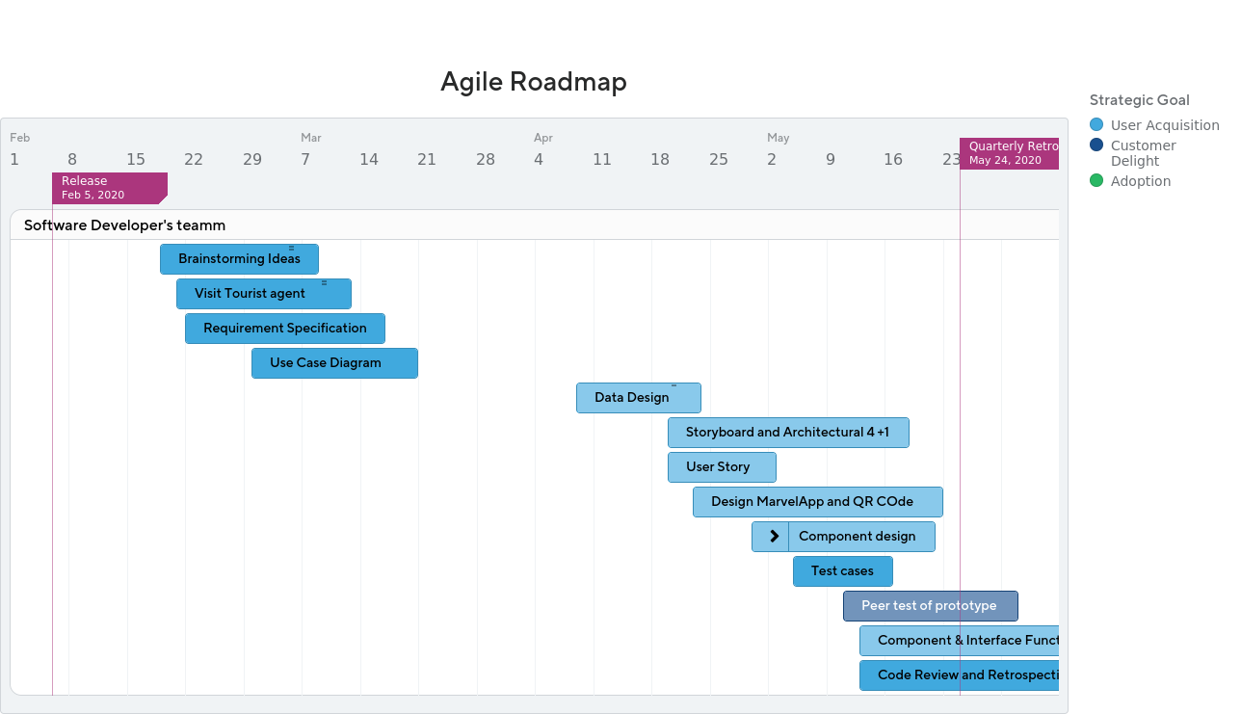
Roadmap with Release Plan
S
Notes:
Brainstorm (2020/02/19)
Conducting a research on a tourism to find a solution that will help the Tourism increase in Cape Town: By Sebe and Moipone
Visit Tourist Agent called LoveCapeTown (2020/02/21)
Visit a tourism agency to get brilliant ideas on how their system works in helping tourists have a luxurious vacation in Cape Town to help us have a view and understanding of how actually the tourism space is structured and what tourists actually need and do: By Sebe and Moipone
Requirement Specification (2020/02/22) to (2020/02/25)
Documenting down the user and system requirements of how our mobile system is going to be built and operate: By Sebe and Moipone
Use Case Diagram - (2020/03/01) to (2020/03/02)
Designing a Use Case Diagram to show how users(actors) interact with the system. By Moipone.
Data Design (ERD/Class Diagram) - (2020/04/09) to (2020/04/10)
This is to help show how the parts of the system are connected together and the relationship within the system: By Sebe
Storyboard - (2020/04/17) to (2020/04/19)
Design a storyboard for our TourSpace application: By Moipone
Architectural Design using 4 + 1 Method - (2020/04/20) to (2020/04/21): By Moipone
User Story (Prototype) - (2020/04/21) to (2020/04/21): By Sebe
Demonstration using MarvelApp and QR code - (2020/04/23) to (2020/04/28): By Sebe and Moipone
Component design - (2020/04/30) to (2020/05/05): By Sebe and Moipone
Test Cases - (2020/05/05) to (2020/05/05): By Moipone
Peer test of prototype - (2020/05/11) to (2020/05/11): By Sebe and Moipone
Component & Interface Functionality (Demo) - (2020/05/13) to (2020/05/13): By Sebe and Moipone
Code Review and Retrospectives (write up) (2020/05/13) to (2020/05/13): By Sebe and Moipone

Slide 9
Thank you.

